Slide 1

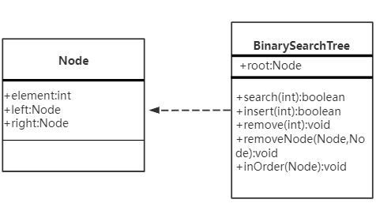
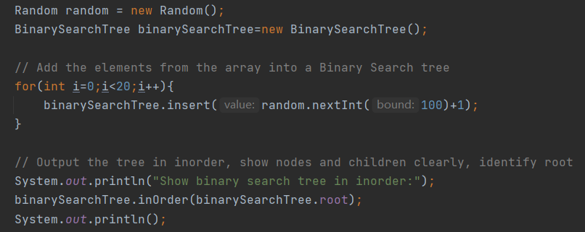

Ⅰ. Using java to complete tasks
Preparation:
Create a Node class.
Create a Binary Search Tree class.
Steps to complete the task:
Create Random instances.
Passing random numbers into the BST with the help of for loop.
Complete the corresponding operations on the BST.
......

Slide 2
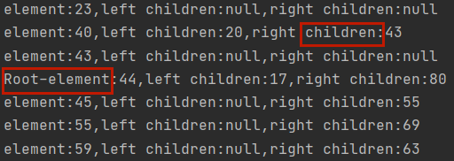
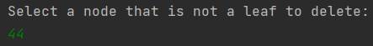
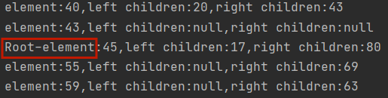
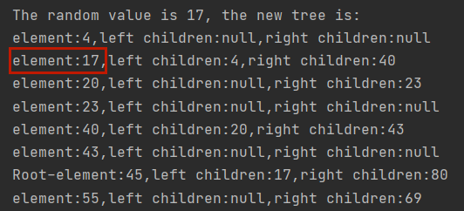
Ⅱ. Results presentation in java
1. Show BST by inorder
2. Delete a node that is not a leaf
3. Add a node to BST with random value

Slide 3
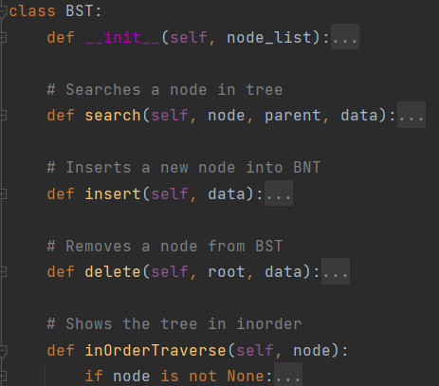
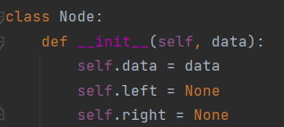
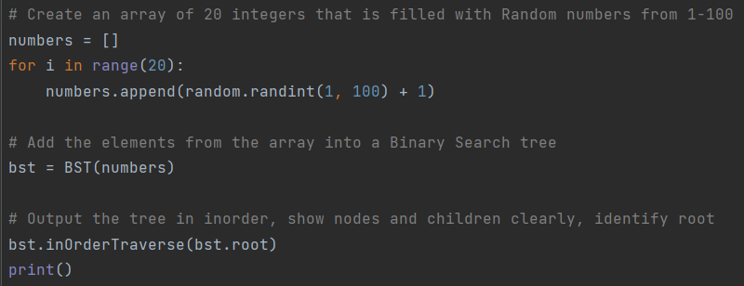
Ⅲ. Using python to complete tasks
Preparation:
Create a Node class.
Create a Binary Search Tree class.
Steps to complete the task:
Create an array of random numbers.
Passing arrays into the BST.
Complete the corresponding operations on the BST.
......

Slide 4
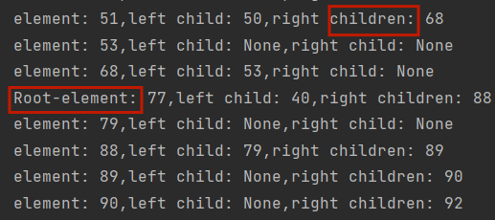
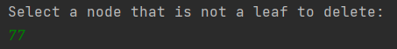
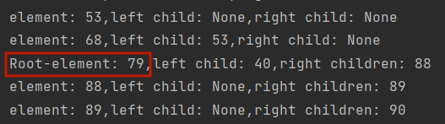
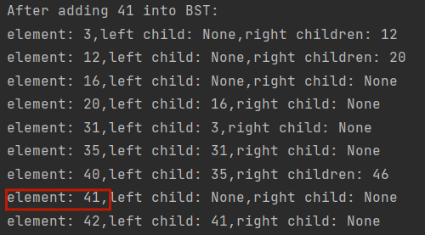
Ⅳ. Results presentation in python
1. Show BST by inorder
2. Delete a node that is not a leaf
3. Add a node to BST with random value

Slide 5
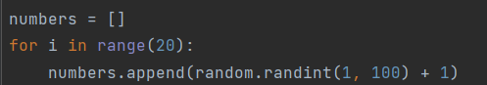
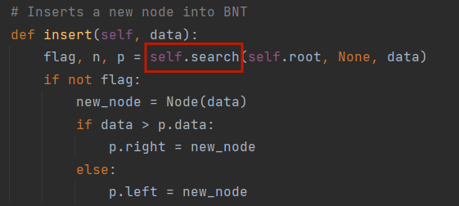
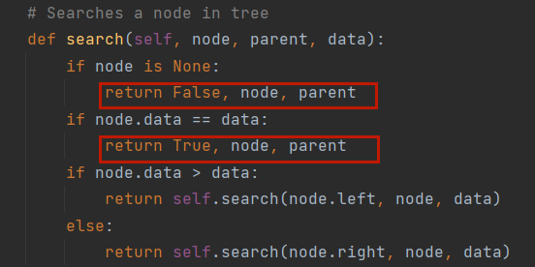
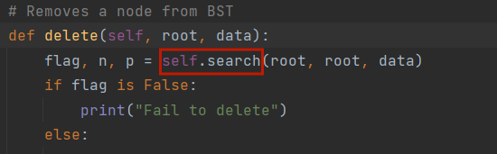
Ⅵ. Differences with the two language implementations
1. Variables need to be declared in java, but not in python.
2. Java ends each line with a semicolon, python controls the structure with indentation.
3. Python can return multiple values, java can not.

Slide 6
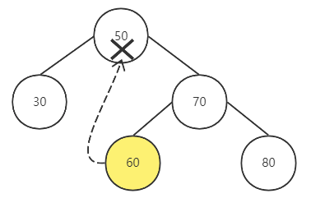
Ⅶ. Challenges with the two language implementations
Delete a node that is not a leaf
Ⅷ. Conclusion
Java's object-oriented thinking is conducive to improving the reusability of code.
Python absorbs the advantages of java and is more concise as a scripting language.

Slide 7
Ⅸ. Resource
https://blog.csdn.net/m0_57180439/article/details/123035613
https://m.w3cschool.cn/article/94926388.html
https://blog.csdn.net/fengxiandada/article/details/123735085
https://blog.csdn.net/u010089444/article/details/70854510?spm=1001.2014.3001.5506

